Slide 1
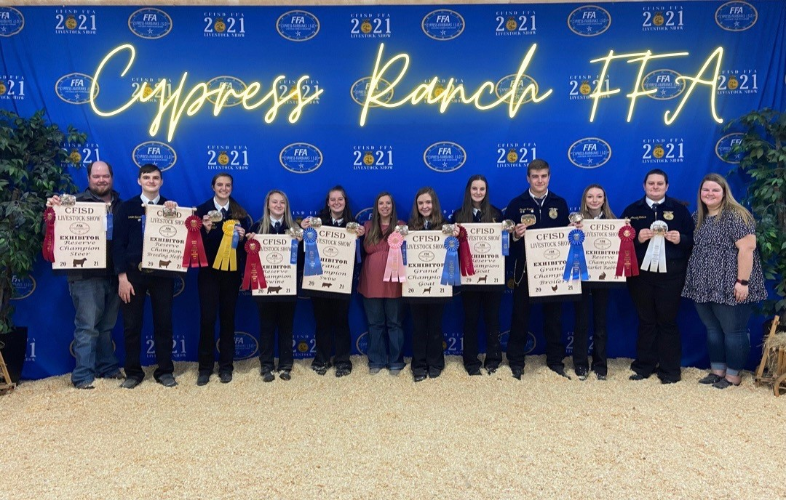
Livestock Show

Slide 2

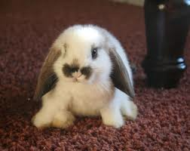
Feeding Theory
Remember from the pen to the plate!!!!
They are not pets!!!
They are for the purpose of producing meat!!!

Slide 3
FFA Dues
You must pay your FFA dues before we will except paperwork
You are not considered a member in good standing until your dues are paid.
Dues: $30.00

Slide 4
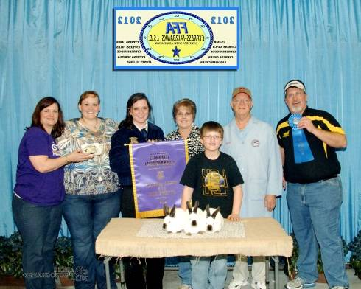
Teacher
Rabbits
Cost estimate: $200-500.00
Supplies
Feeders
Water bottles
Nesting box
Food scale
Exercise
No exercise required, but you do need to handle your rabbits daily
Work hair-run hand back and forth from head to rear, daily- 3 wks from show
Use baby wipes to remove stains
Housing
Cage-small wire, best frame-pvc, 3 sq ft min per rabbit
Good ventilation
Cover
Feed Requirements
Protein- 15-18%
Meat pen- fresh feed in front of at all times
Does with no babies watch weight
Showbloom
Show Weight
3 babies must be as close to 5.5 lbs. as possible
Must be between 3.5-5.5 lbs.
Age- 70 days is ideal
Remember this is just a reference and
you don’t have to follow these suggestions.

Slide 5
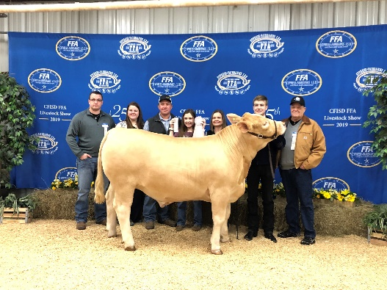
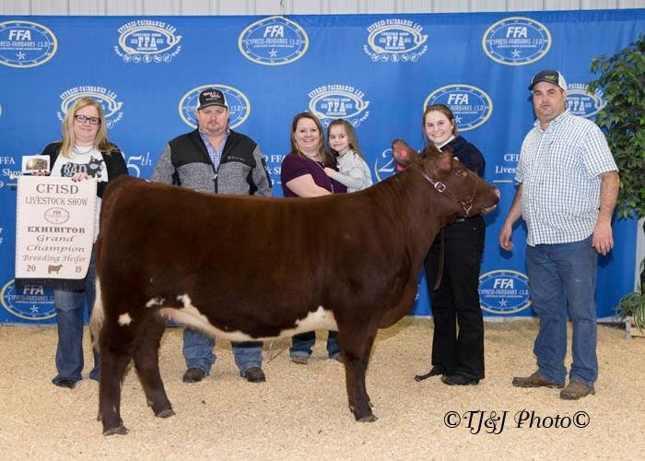
Cattle
Supplies
Halter
Feeders
Waterers
Show stick
Neck sweat
Hay bag
fan
Cost estimate: $5000.00
Housing
Min 144 sq ft
Clean shavings
Good ventilation
6’ min height panels
Free from hazards
Exercise
Out of pen everyday
Walking-20-30 minutes a day
Turn out in pasture- several times a week for 30 min- 1 hr
Websites
Steerplanet.com
Showsteers.com
Feed Requirements
Protein- 11-20%
Feed-2-3% of body weight
Clean water
Grass
Hay- 2+ flakes a day
Alfalfa-small increments
Deworm- every 30 days
Remember this is just a reference and
you don’t have to follow these suggestions.

Slide 6
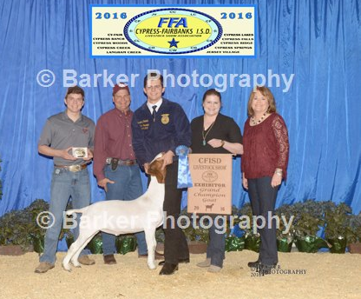
Goats
Cost estimate: $1300.00
Purchase Price: $775
Exercise
Out of pen everyday
Hand walking
Bracing
Running- 10-20 minutes, 5-6 days a week
Housing
Min 60 sq. ft. per goat
Clean shavings
Good ventilation
4’ min height panels
Free from hazards
Structure to climb on
Centerblocks at feeders
and waterers
Supplies
Collar-chain
Halter
Feeders
Water bucket
Sock/blanket
Muzzle
Feed Requirements
Protein- 15-18%
Fat- 2.5-4.5%
Fiber- 15-19%
Clean water
Grass
Hay
Deworm- every 30 days
Websites
Showgoatpage.com
Texasgoat.com
Texasshowgoatconnection.com
Remember this is just a reference and
you don’t have to follow these suggestions.

Slide 7
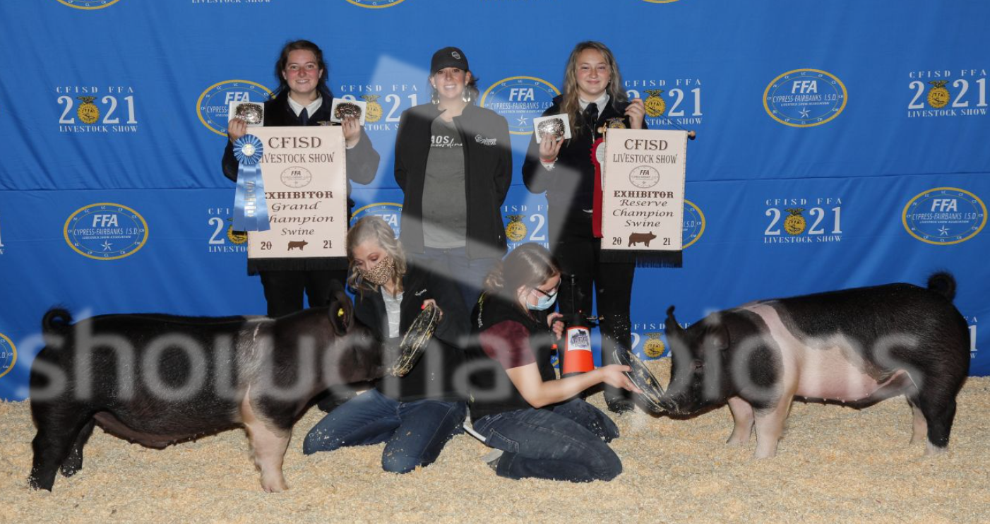
Swine
Cost estimate: $1700.00
Purchase Price: $300.00
Supplies
Whip
Hanging feeder
Waterers-nipple
Brush-rice root and horse hair
Shampoo/oil
Housing
Min 60 sq. ft.
Clean shavings
Good ventilation-Fans
3’ min height panels
Free from hazards
Feed Requirements
Protein- 16-20%
Fat- 3.5-6.5%
Clean water
Protein/fat supplement
Exercise
Out of pen everyday
Walking-15-20 min a day everyday, when they are bigger
Teaching to walk with head up
Remember this is just a reference and
you don’t have to follow these suggestions.

Slide 8
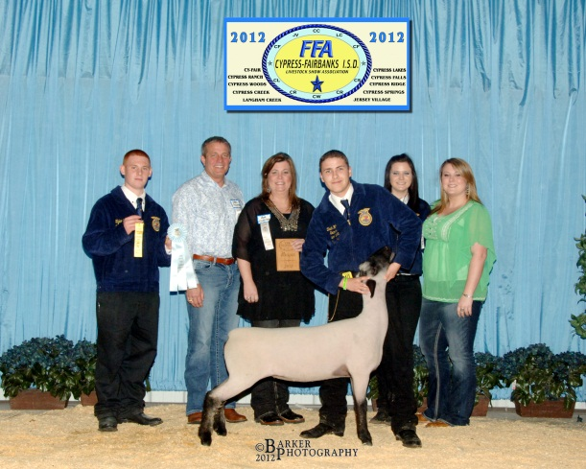
Lambs
Supplies
Halter
Feeders
Waterers
Sock/blanket
Center blocks
Toys
muzzle
Cost estimate: $1000.00
Purchase Price: $374.00
Housing
Min 60 sq. ft. per goat
Clean shavings
Good ventilation
4’ min height panels
Free from hazards
Structure to climb on
Centerblocks at feeders and waterers
Exercise
Out of pen everyday
Hand walking
Bracing
Running- 20-25 minutes, 5 days a week
Websites
Mylamb.org
Feed Requirements
Protein- 16-18%
Fat- 2.5-4%
Clean water
Grass
Hay
Alfalfa-small increments
Deworm- every 30 days
Remember this is just a reference and
you don’t have to follow these suggestions.

Slide 9
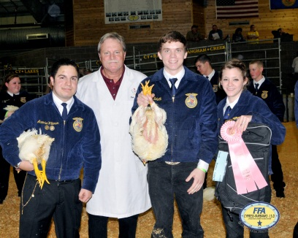
Poultry
Supplies
Feeders
Waterers
Should be placed every 2 ft
Cost estimate: $600.00
Purchase Price: $45/box of 25 + $25 entry
Housing
Min 2 sq ft per bird
Clean shavings
Good ventilation
2’ min height panels
Free from hazards
Heat Lamps
Feed Requirements
Protein- 15-18%
Fat- 2.5-4.5%
Fiber- 15-19%
Clean water
Protein- from arrival to 3 wks. (chickens)
Liquid fat- 3-6 wks (chickens)
Turkeys first half-protein,2nd half fat- be cautious w/ fat once you start you cannot stop. .
Exercise
Make the animals move as much as possible, if they are not moving they are not eating
Constant movement- rabbit, radio, deer feeder with rocks in can
Remember this is just a reference and
you don’t have to follow these suggestions.

Slide 10
Feed
Livengood
Tomball
281-255-2668
showrite
sunglo
Anytime Feed
34423 Owens Rd, Hempstead
281-753-0209
Acco-Showmaster
Lindner
Kent
Cypress Ace Hardware & Feed
11655 Jones Rd-
281-469-8020
Purina, linders
Spring Creek Feed Center
26211 FM 2978, Magnolia
281-252-5400
Purina
Heiden Feed & Supply
14403 Stuebner Airline
281-444-1010
Purina
Lindners
Surefed
Moormans
D&D Feed
16915 FM 2920,Tomball
281-351-7144
Purina
Showrite
High Noon
Lonestar
Circle N
29503 FM 1499 Waller
936-372-3491
Nutrena
Lonestar
West
Tractor Supply
Tomball, Katy
Purina
Nutrena
Haney Feed & Farm
2614 Washington St, Waller
936-372-3652
Purina
All Species
Steinhausers
Brookshire, Magnolia,
Hempstead
Purina
Kent
MG feed
Teachers can give you more information
Supplements
Oxygen
www.oxyinfo.com
Champions Choice
4u2winsupplements.com
Showbloom
www.standalonefeed.com
All breeds
www.essentialshowfeeds.com
Natural Solutions
Naturalsolutionsforlivestock.com
Champion Drive
Purinamills.com
Vets
Washington Animal
Clinic (979) 836-4531
Navasota Beard
936-825-3877
Baker Vet Clinic
(936) 857-3207
Star Hill Veterinary Clinic
979-865-2192
Remember this is just a reference and
you don’t have to follow these suggestions.

Slide 11
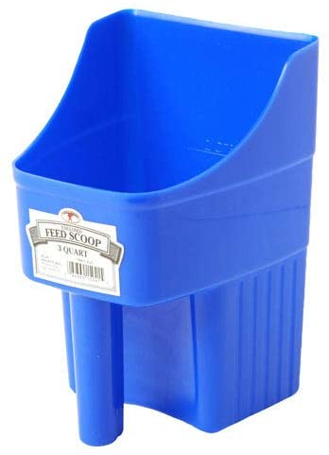
Feed
Please do not buy a starter pack from a feed store. They include things you do not need and include feeds we do not recommend.
We have some supplies for sale in the shops.
Please do not buy one of these either. That will not help when we talk about feed weight.

Slide 12
CFISD Livestock Show

Slide 13
SHOW
Show- February 1st -4th 2023
Payment- Sept 15, 2022 by money order/cashiers check or school cash online. District really wants school cash but we can take money order/cash.
All entries must be emailed or faxed into the district. It is not considered submitted if just given to the teachers.
Sheep, goat, hog Draw October 5th. Time to be announced
Lamb Selection- Oct 7th, 2022
Goat Selection- Oct 6th, 2022
Swine Selection- Oct 8th, 2022
Shearing- January 27th -29th exact times and dates to be announced as we get closer.

Slide 14
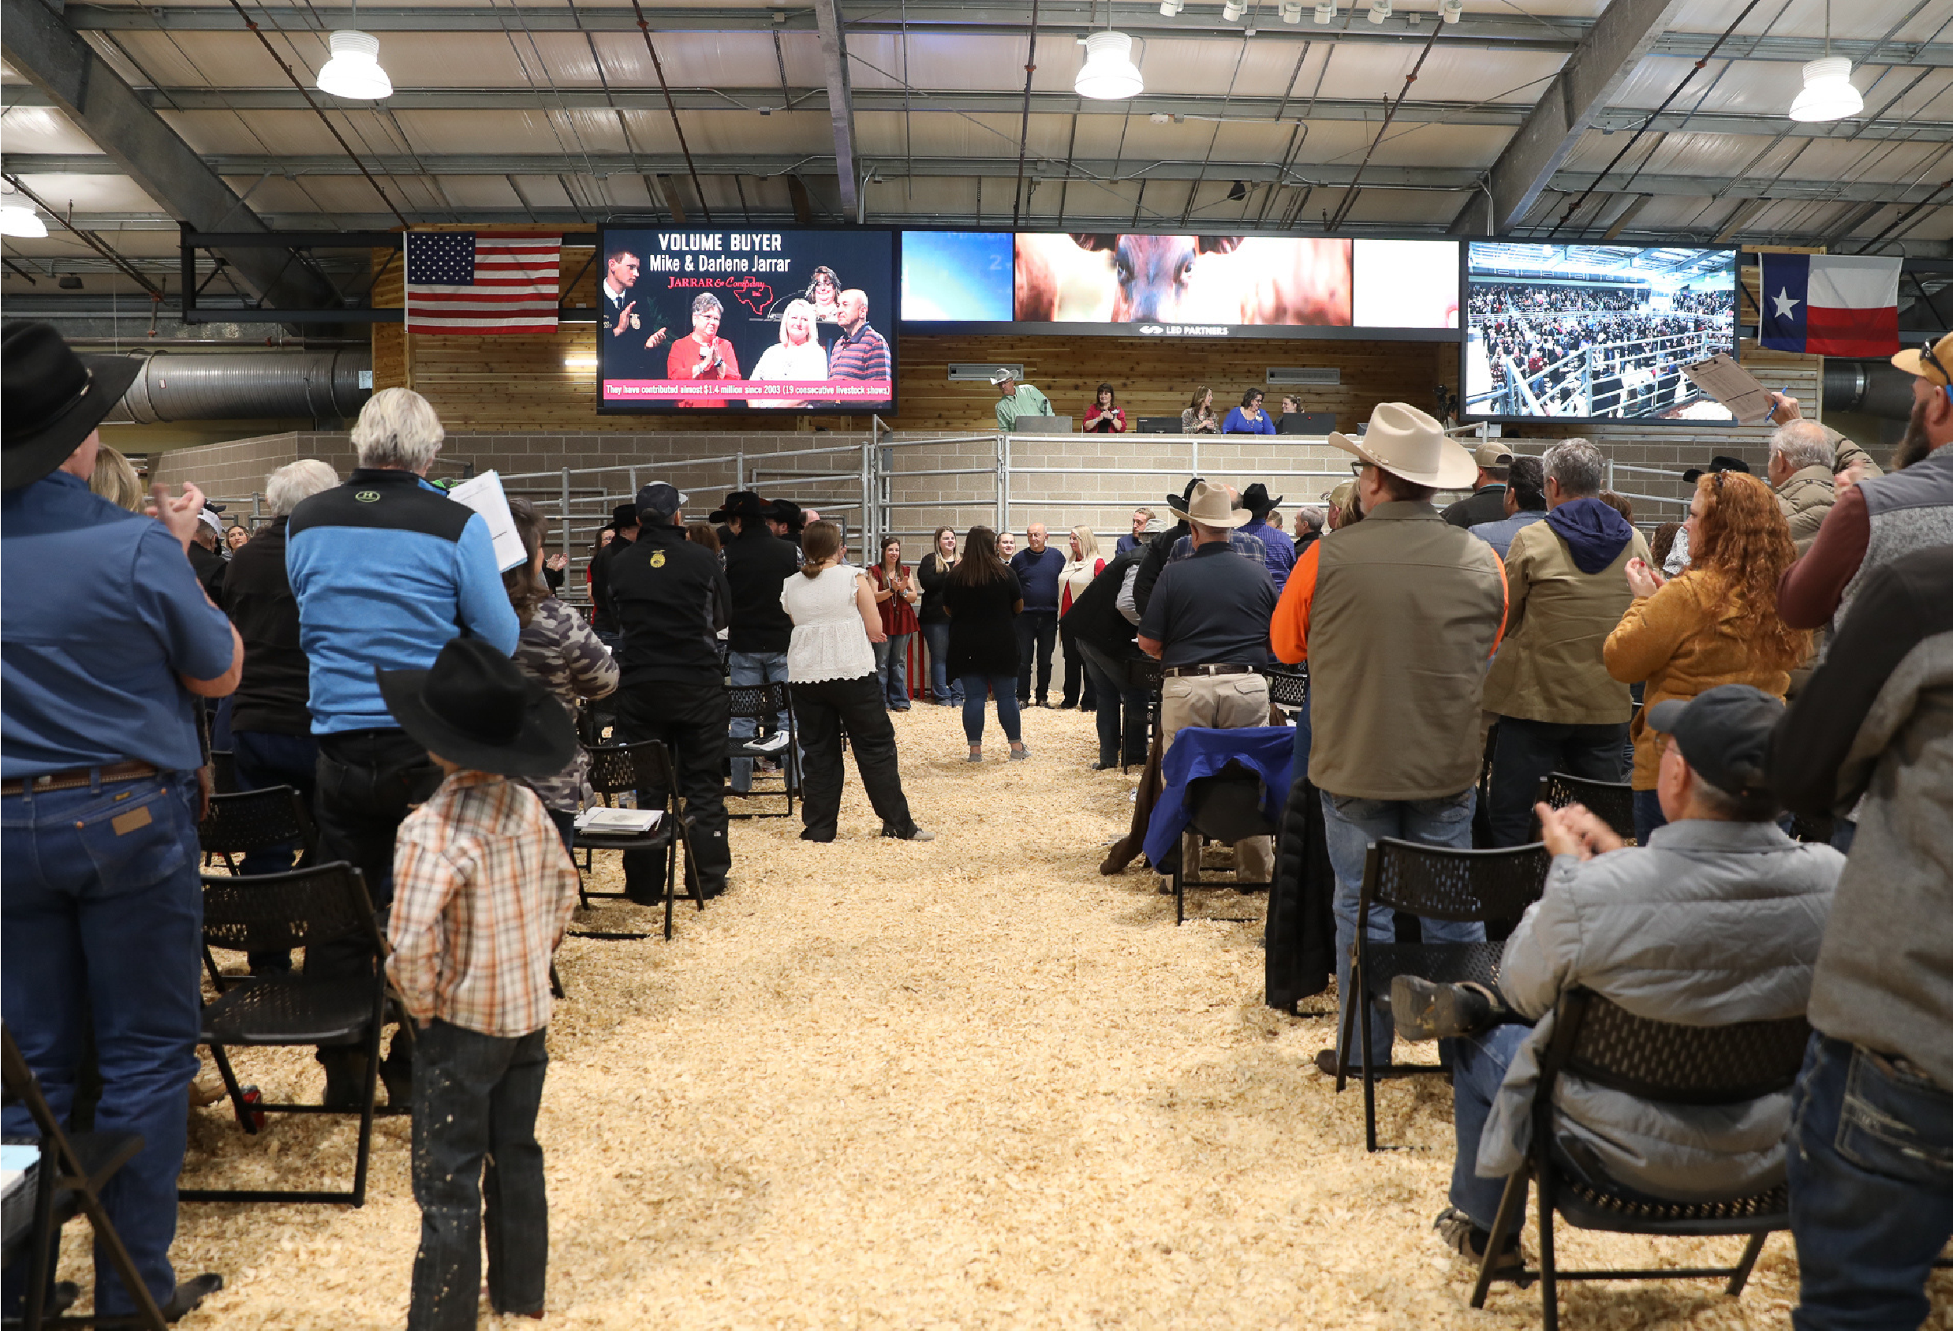
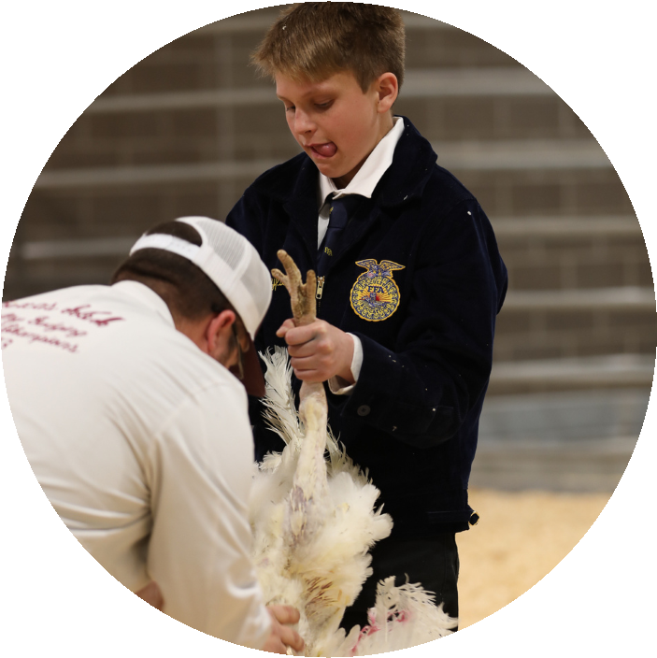
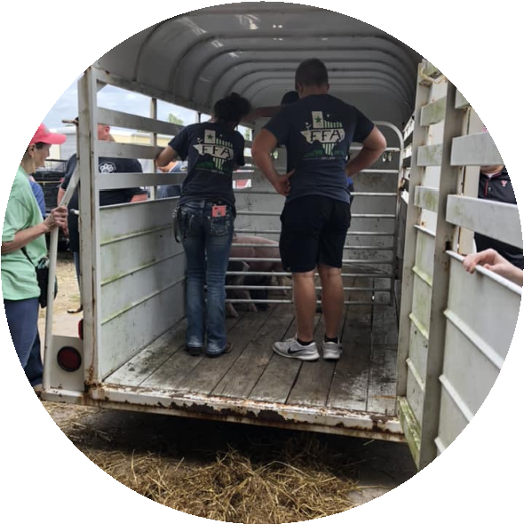
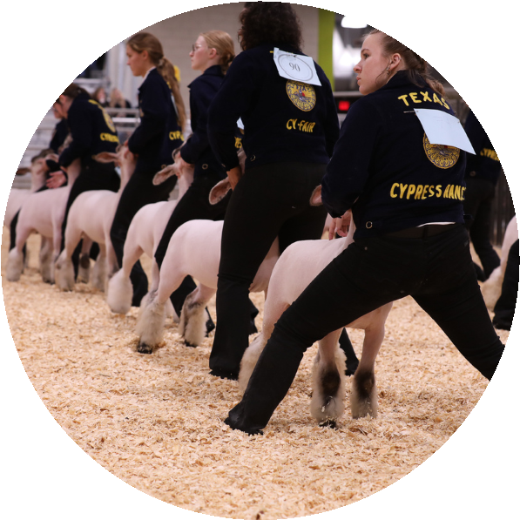

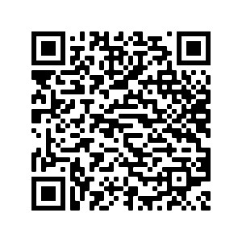
LIVESTOCK SHOW &
SALE
Schedule of Events
Thursday, February 2, 2023
8:00
am - Rabbit Judging*
11:00
am - Goat Judging*
3:00
pm - Cattle Judging*
Need more
*Items added to Online Freezer Sale by following morning.
info?
Friday, February 3, 2023
8:00
am - Poultry Judging*
Saturday, February 4, 2023
8:00
am - Ag Mech/Horticulture Judging
9:00
am - Freezer Sale Continues* &
10:00
am - Lamb Judging*
Silent Auction Opens
1:00
pm - Swine Judging*
11:00
am - Buyers Luncheon
6:00
pm - Ag Mech/Horticulture Awards
1:00
pm - Premium Sale (Live Auction
)
*Items added to Online Freezer Sale by following morning.
Contact Us
+281-897-4036
https://sites.google.com/cfisd.net/cfisd-lsa/home
@CFISDLSA

Slide 15
Animal Cost
Swine $300.00 each (This price includes the $25 entry fee.)
Lambs $374.00 each (This price includes the $25 entry fee.)
Goats $775.00 each (This price includes the $25 entry fee.)
Broilers $45.00 per box (25 broilers per box) and $25.00 entry fee* price has not been confirmed for this year yet
Turkeys $25.00 entry fee (maximum of 1) (purchased in the spring)
Steers- payment TBD these are purchased in Feb of the previous year

Slide 16
Cost Continued
Breeding Rabbits $25.00 per head entry fee (maximum of 1) (purchase on your own)
Market Rabbits $25.00 per pen entry fee (maximum of 1 pen) (purchase on your own)
Heifers $25 entry fee per heifer (maximum of 2, must be in different age classes) (purchase on your own)
Ag Mech $25 entry fee per entry (maximum of 2, must be in different project classes AND maximum of 5 students on group
Horticulture ENTRY FORMS AND $25 ENTRY FEE DUE: Tuesday, December 8, 2020, faxed or emailed in to district(maximum of 2 entries not in the same division)

Slide 17
District Barns
    District barn locations:
    Telge across from Cy-Fair HS
    Eldridge next to Cy-Ridge HS
    Westgreen Behind Cy Park HS
    You are only allowed one animal in a District Barn this year.
    You can choose to use any of the district barns. We prefer Telge but are willing to go where it fits you the best.

Slide 18
Barn Fees
Swine- $150.00 $100 refundable
Goats- $150.00 $100 refundable
Lambs- $150.00 $100 refundable
All poultry, rabbits, and heifers are not allowed in the school barns.
Students may house any project at their own facilities as long as it is within 20 miles of the CFISD boundaries.
Read the rules as many have changed!!!!!!!
Barn Police

Slide 19
Barn Times
As of right now there are no designated barn times.
The barn is open from 530am to 10pm

Slide 20
Show Requirements
Official outdoor dress
Passing all classes for the 2nd Marking period. There will be a progress report this year
Be enrolled in at least one agriculture class for one semester within the school year
Be a paid member of FFA you can pay through schoolcashonline.

Slide 21

Requirements to Receive Check
Thank you letters written in class and given to AST to mail
If you would like to hand deliver a thank you letter than is fine but you will still be mailing one form the school.
Picture if applicable delivered and confirmation given to AST in official dress
Pen cleaned out (if in barn) within 7 days of auction. Pen deposit will be refunded as well
Completed Recordbook
  All expenses
  All journal hours (FFA and school activities)
  SAE plan complete

Slide 22

Grades
Must be passing everything on the 2nd marking period report card or passing all classes on the or passing all classes on the eligibility check for the 3rd marking period. If your animal is in the school barn you must remove within 7 days from the time of the failing report card or progress report
You will not be reimbursed for any expenses that you have occurred for your project
You cannot sell your animal in the freezer sell or premium auction.
Bottom Line- PASS YOUR CLASSES!!!!!!!!!!!

Slide 23
BUYERS
Who are buyers?- business owners, grandma, aunts, uncles, your neighbors
How do I get buyers?- invitations will be handed out in December to invite buyers to the show
Add-Ons
Add-Ons- are exactly that… money added on to the purchase price of the animal
Who gives- grandma, uncle, aunt, boss, etc.

Slide 24
BUYERS
You are responsible for obtaining your own buyers and you need to start as early as possible.
Send or deliver personalized invitations early is always best. Take your buyers baked goods when you invite them and make sure you are in Official Dress!

Slide 25
Premium Sale vs. Freezer
Premium Sale- 25% of Steers, Lambs, Goats, Poultry, and Rabbits make it to the Premium Sale (Live Auction). The top 25 swine.
Freezer Sale- everyone else
Pricing
Horticulture and Ag Mech- Silent Auction
Poultry and rabbits- $150.00 per pen
Steers- $2.50 per pound weight at check in
Lambs- $400.00
Goats-$400.00
Swine- $450.00

Slide 26
Breeders
Heifers and Breeding Rabbits are shown for prizes only, they cannot be sold in the auction.
Market Rabbits: starting this year you can purchase a market pen of rabbits to exhibit.

Slide 27

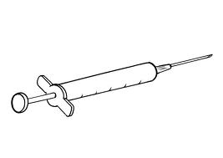
Drug Testing
You cannot use illegal drugs (steroids or anything not labeled for your species of animal)
Three market animals of each species will be randomly drug tested

Slide 28
Paperwork
https://sites.google.com/cfisd.net/cfisd-lsa/home or cyranch.ffanow.org
What paperwork is needed: The forms are fillable
  Entry Card
  Market Certification
  Barn Application and Agreement (if applicable) (Parent/Student Agreement
  Medical Form/Parent Permission
  You must complete one form for each animal
  All animals may be paid for on one Money Order or Cashiers Check, School Cash
  All Due Sept 9, 2021 3pm,
  Must have FFA dues paid before this date as well.
  no exceptions.

Slide 29
Animal Information
If there is specific information on an animal please put down your name and email on one of the sheets in the back.

Slide 30
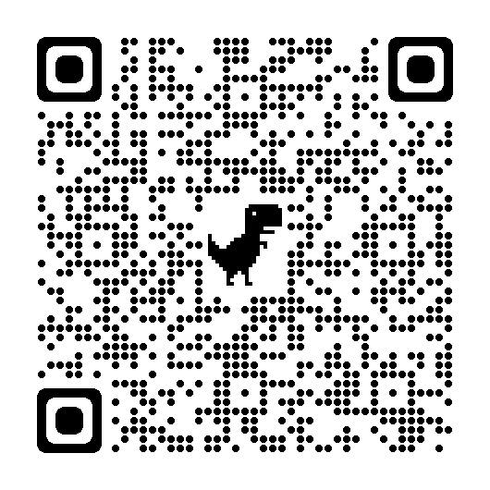
Please scan if you are coming to the first chapter meeting

Slide 31
Contact
Phone: 281-373-2321
Website: cyranch.ffanow.org
Email:
  Kaitlyn.georgiou@cfisd.net
  Cory.Shearer@cfisd.net
  Thomas.Palisin@cfisd.net
  We will now take questions

